Slide 1

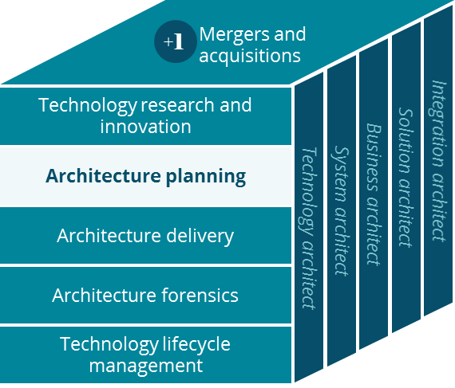
Commercial – National Account Business Canvas
Architecture Planning
Grace Lee
3/2019

Slide 2
Business Canvas
National Account
Sales / Service / Delivery
Key Partnerships
Key Activities
Value Proposition
Customer Relationships
Customer Segment
Clearing House
PBM
Prospect Customers
Manage Account
Better & Easy Service
HR
Clinical professionals
Providers
Full Insured Admin
Self Insured Admin
Lower Member Cost
Employees
Employee Department
Plan sponsors
Deliver Service
Manage National Network
Brand Recognition
Consulting Firm
National Account Fully Insured
Dedicated Sales Reps
Hospitals
Pay Providers
Forecast (Cost & Rate)
Quality of Service
Joint Venture
Vendors
Channels
National Account
Self Insured (ASO)
Key Resources
Bigger National Network
Digital
(Aetna Health)
Mail
ACO
States
Local Presence
CVS / Aetna Brand
TPA
Auxiliary Product Outsource
Digital Platform
Data & Insights
Cost Containment
Vendor Portals
Face to face
IT Platform
Preventative Health Care
Highly customized products
Phone, Fax, Chat & Emails
Video (TeleDoc)
Minute Clinic
Customer Care
Low Premium
Digital Assets
Cost Structure
Revenue Streams
Marketing & Sales
Operational Costs
Research & Development
General & Administrative Costs
PMPM (Per Member Per Month)
PMPM ASO
Stop-loss insurance for ASO
Long Term Investment
Notes:
National & Middle Market :
high on-boarding cost
long-term contracts with low margin
brand reputation
large population – bargaining power with hospitals, and strong analytic science – personalized experience, new innovative features experiment
via consulting firm hired by plan sponsor
high degree of customization… accommodating products, plans, networks… United : employees telling what doctors they want to see
We promise cost down and local market presence, and guarantee (guarantee – financial penalty for national accounts)

Slide 3
Glossary
Glossary | Description
Clinical professional | Pharmacists, nurse practitioners, community liaisons and social works
IPA | Individual Partitional Association
ASO | Administrative Services Only
ACO | Accountable Care Org
Stop-loss insurance | Aetna provides stop-loss insurance for national account and middle market ASO. Stop-loss insurance is based on cash flow monthly for claims.
AFA | Aetna Funding Advantage for small group
ACC | Aetna Community Care. Face to Face = Minute Clinic, Pharmacy, ACC
TPA | Third Party Administrator
Providers | Providers, Hospitals, Clinical Professionals
Auxiliary Product Outsource | Vision and Dental Partnerships for Care and Wellness
Value Proposition | Based on Better Service, Easy Service, and Lower Cost

